Slide 1
Analysis and Design of Algorithms
ENCS202
Unit-1
Introduction to Algorithms
Session 1:Characteristics of Algorithm
Dr. Vandna Batra​
​

Slide 2

Session 1: Characteristics of Algorithm
Introduction to Algorithm
Properties of an Algorithm
Characteristics of an Algorithm
Analysis of an Algorithm
Importance for Analysis of an Algorithm
Complexity of an Algorithm
Time Complexity
Space Complexity
Test Your Knowledge
Recap
References
Notes:
New Courses replaced with New Programmes

Slide 3
Learning Outcomes (Session 1)
By the end of this session, students will be able to:
Define an algorithm and distinguish it from a program
Identify key properties and characteristics of algorithms
Explain time and space complexity with simple examples
Notes:
New Courses replaced with New Programmes

Slide 4
Quick Warm-Up: Think & Respond”
“Have you written a program before?” (Yes / No)
Poll: Is this an Algorithm?
A recipe for baking a chocolate cake.
A user manual for changing a flat tire
A C++ source file (sort.cpp) that organizes numbers
GPS giving turn-by-turn directions to the mall.
Notes:
New Courses replaced with New Programmes

Slide 5
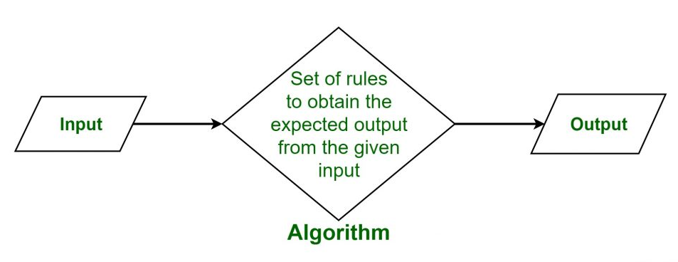
Algorithm?

Slide 6
Algorithm?
An algorithm is a finite sequence of well-defined instructions that can be used to solve a computational problem. It provides a step-by-step procedure that convert an input into a desired output.
Algorithms typically follow a logical structure:
Input
Processing
Output

Slide 7
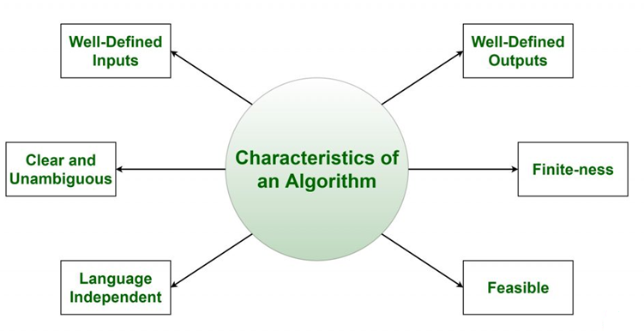
Characteristics of an Algorithm

Slide 8
Pseudocode: Bridging Algorithm and Program
Pseudocode is a structured, English-like way to represent an algorithm.
It focuses on logic, not syntax.
Language-independent and easy to understand

Slide 9
Algorithm vs Pseudocode
Algorithm | Pseudocode
Conceptual steps | Structured representation
Plain language | Semi-formal notation
No standard format | Common conventions
Why do we not write algorithms directly in C++/Java first?”

Slide 10
Simple Example
Problem: Add two numbers
Algorithm (natural language):
Start
Read A, B
Compute C = A + B
Print C
Stop

Slide 11
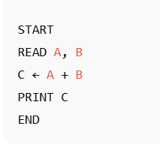
Simple Example
Pseudocode:
This models how thinking becomes structure.

Slide 12
Program: Implementation of an Algorithm
A program is a coded version of an algorithm.
Written in a specific programming language.
Must follow strict syntax rules

Slide 13
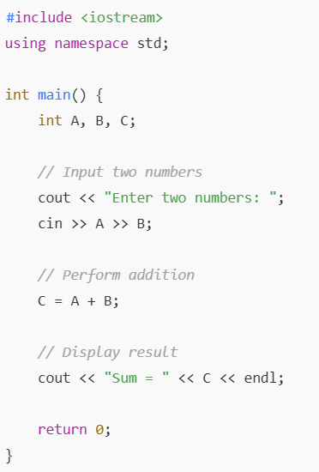
Program Example (Addition of two numbers)

Slide 14
Algorithm vs Program (Common Confusion)”
Algorithm | Program
Step-by-step logic | Implementation in a language
Language-independent | Language-dependent
Conceptual | Executable
“Can the same algorithm be written in C++, Java, and Python?”

Slide 15
Think–Pause
“Can one algorithm have multiple programs?” Why?

Slide 16
Properties of Algorithm
1. Finiteness
Property: An algorithm must terminate after a finite number of steps.
Example:
Algorithm: “Keep adding 1 to a number forever.”
❌ This is NOT an algorithm because it never stops.
Valid Example:
“Add 1 to a number 10 times and stop.”
✅ Finite number of steps → Valid algorithm

Slide 17
Think–Pause
“ Does a loop without an exit condition is an algorithm?”
START
i ← 1
while (true) do
print i
i ← i + 1
END while
END

Slide 18
Properties of Algorithm
2. Definiteness (Unambiguity)
Property: Each step of an algorithm must be clearly and precisely defined.
Example (Invalid):
Step: “Add 5 or 6 to x.”
Unambiguous?
Valid Example: :
Ex1: "Add 5 to x" (Definite).
Ex2: “Add A and B, store the result in C.”
✅ Clear and unambiguous

Slide 19
Think–Pause
“Can two people interpret this step differently?”
Add A and B and store the result in C.

Slide 20
Properties of Algorithm
3. Input
Property: An algorithm has zero or more well-defined inputs.
Example:
Algorithm: “Calculate the square of a number.”
Input: One number n
Another Example:
Algorithm: “Print ‘Hello World’.”
Input: None (zero input is allowed)
➡️ Both satisfy the input property.

Slide 21
Properties of Algorithm
4. Output
Property: An algorithm must produce at least one output.
Example (Invalid):
Algorithm:
Reads numbers but does not display or return anything
❌ No observable result
Valid Example:
Input: A, B
Output: Sum = A + B
✅ Output is clearly defined

Slide 22
Properties of Algorithm
5. Effectiveness
Property: All operations must be basic and executable in finite time.
Example (Invalid):
Step: “Sort the numbers instantly.”
❌ “Instantly” is not realistic or defined
Valid Example:
Step: “Compare two elements and swap if needed.”
✅ Basic and feasible operation

Slide 23
Properties of Algorithm
6. Feasibility
Property: The algorithm must be practical with available resources.
Example (Invalid):
Algorithm requires 10 TB of memory on a normal computer
❌ Not feasible
Valid Example:
Algorithm sorts 100 numbers using available memory
✅ Feasible with real systems

Slide 24
Properties of Algorithm
7. Independence (Language Independent)
Property: An algorithm should not depend on any specific programming language.
Example:
Algorithm written in plain English or pseudocode
Same steps can be coded in C++, Java, or Python
➡️ Logic remains the same, only syntax changes.

Slide 25
Test Your Knowledge
1. Which of the following best defines an algorithm?
(A) A set of rules for solving a problem in a finite amount of time.
(B) A computer program written in a high-level language.
(C) A flowchart describing a problem.
(D) A mathematical formula.

Slide 26
Test Your Knowledge
Q) If an algorithm runs forever, which property does it violate?
Answer: Finiteness
Q) True or False:
Statement: Pseudocode is a formal programming language that a computer can execute directly.
Answer: False
Q) “Is recursion violating finiteness? Why or why not?”

Slide 27
Test Your Knowledge
Q) If a procedure for calculating prime numbers is correct but never stops running, which property of an algorithm does it violate?
A. Input.
B. Finiteness.
C. Output.
D. Effectiveness.
Answer: Finiteness.

Slide 28
Session 1 Summary: Foundations of Algorithms
1. What is an Algorithm?
Input ->Processing ->Output.
2. The Logic Bridge (Key Distinction)
Algorithm: The abstract logic (The Recipe).
Pseudocode: Structured English blueprint (The Instructions).
Program: Executable code in C++/Java (The Actual Dish).
3. The 5 Essential Properties (F-D-I-O-E)
4. The "Golden Rule" An algorithm is Language Independent. We design the logic first to ensure efficiency and clarity before writing a single line of C++ or Java code.

Slide 29
References
Textbooks
Ellis Horowitz, Sartaj Sahni, Sanguthevar Rajasekaran – Fundamentals of Computer Algorithms
Cormen, Leiserson, Rivest, Stein (CLRS) – Introduction to Algorithms
Online Resources
MIT OpenCourseWare: Introduction to Algorithms (ocw.mit.edu)
GeeksforGeeks: What is an Algorithm | Introduction to Algorithms - GeeksforGeeks

Slide 30
References
Textbooks
Ellis Horowitz, Sartaj Sahni, Sanguthevar Rajasekaran – Fundamentals of Computer Algorithms
Cormen, Leiserson, Rivest, Stein (CLRS) – Introduction to Algorithms
Online Resources
MIT OpenCourseWare – Introduction to Algorithms https://ocw.mit.edu/courses/electrical-engineering-and-computer-science/6-046j-introduction-to-algorithms/
GeeksforGeeks – https://www.geeksforgeeks.org/dsa/introduction-to-algorithms/

